Slide 1
Network Tour of Data Science
Free Music Alternative Playlists

Slide 2
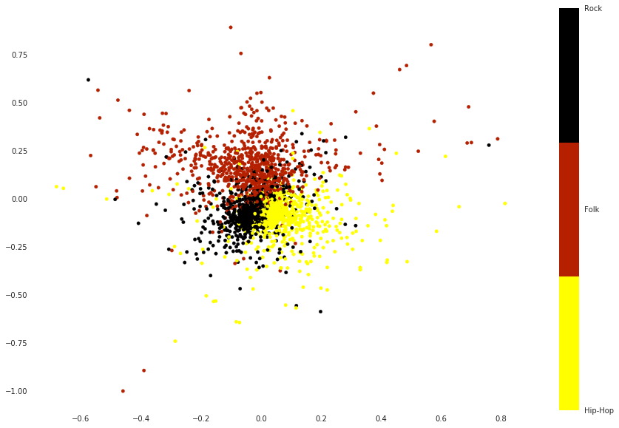
Graph Creation
Distance calculation
Normalization
Type of distance : Euclidean
Spring layout
2 dimensions
3 genres kept
Rock, Hip-Hop, Folk

Slide 3
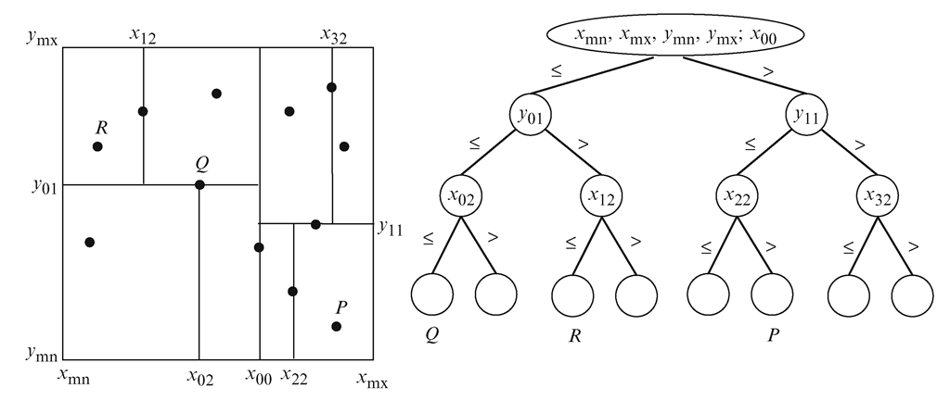
Including our Songs
Recomputation
Placement using a K-D tree

Slide 4
Playlist Generation Methods
518D space
2D graph space
Heat diffusion

Slide 5
518D Features Distances
Same distances used to calculate the adjacency matrix
Closest nodes from each given songs
Expectation : similar features => rhythm, height of voice, tonality… adventurous in regards to genres

Slide 6
2D Spring Layout Graph
Euclidean distance between points in the 2D graph
Again, closest nodes from each given songs
Expectation : very targeted towards a speciﬁc kind of song and genre

Slide 7
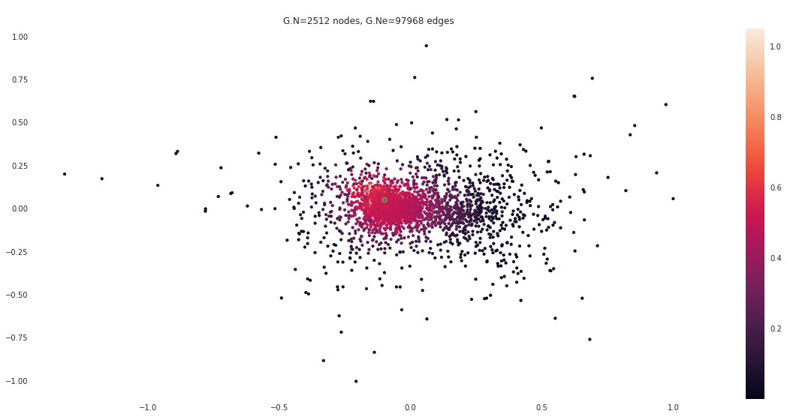
Heat Diffusion
Diffusion from each starting node
Averaging between all contributions
“Hottest” nodes
Expectation : fusion between every given songs properties

Slide 8

Conclusion and Demo
Good separation of genres in 2D
Close performance of different generation methods
Music is a subjective experience, make yourself an opinion !
Input musics
Output musics : 518D
Output musics : Heat
Pharaos -The Pharaos Theme
Pharaos - Mission Bucharest
MC Cullah - A Dangerous Game
Comfort Fit - Sorry
The Impossebulls - Volume Original Demo Instrumental
Wann - Happy Birthday

